Slide 1
Access Control Lists
Notes:
4 - ACL Concepts
4.1 - Purpose of ACLs

Slide 2
What is an ACL?
An ACL is a series of IOS commands that are used to filter packets based on information found in the packet header. By default, a router does not have any ACLs configured. When an ACL is applied to an interface, the router performs the additional task of evaluating all network packets as they pass through the interface to determine if the packet can be forwarded.
An ACL uses a sequential list of permit or deny statements, known as access control entries (ACEs).
Note: ACEs are also commonly called ACL statements.
When network traffic passes through an interface configured with an ACL, the router compares the information within the packet against each ACE, in sequential order, to determine if the packet matches one of the ACEs. This process is called packet filtering.
Notes:
4 - ACL Concepts
4.1 - Purpose of ACLs
4.1.1 - What is an ACL?

Slide 3
Purpose of ACLs What is an ACL? (Cont.)
Several tasks performed by routers require the use of ACLs to identify traffic:
Limit network traffic to increase network performance
Provide traffic flow control
Provide a basic level of security for network access
Filter traffic based on traffic type
Screen hosts to permit or deny access to network services
Provide priority to certain classes of network traffic
Notes:
4 - ACL Concepts
4.1 - Purpose of ACLs
4.1.1 - What is an ACL? (Cont.)

Slide 4
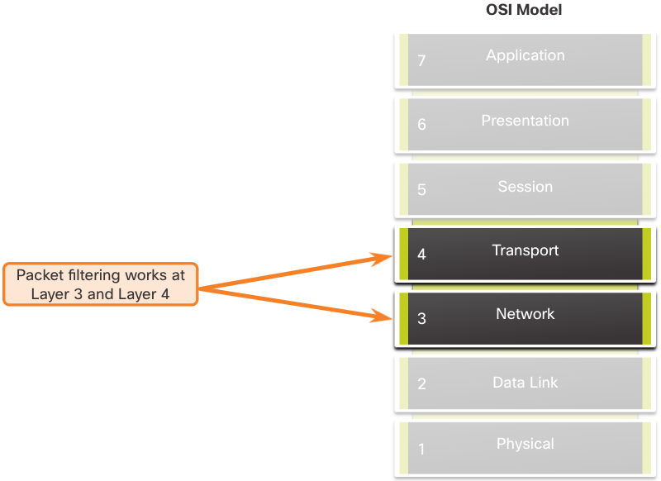
Purpose of ACLs Packet Filtering
Packet filtering controls access to a network by analyzing the incoming and/or outgoing packets and forwarding them or discarding them based on given criteria.
Packet filtering can occur at Layer 3 or Layer 4.
Cisco routers support two types of ACLs:
Standard ACLs - ACLs only filter at Layer 3 using the source IPv4 address only.
Extended ACLs - ACLs filter at Layer 3 using the source and / or destination IPv4 address. They can also filter at Layer 4 using TCP, UDP ports, and optional protocol type information for finer control.
Notes:
4 - ACL Concepts
4.1 - Purpose of ACLs
4.1.2 - Packet Filtering

Slide 5
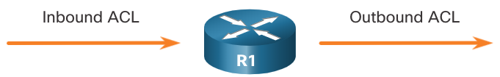
Purpose of ACLs ACL Operation
ACLs define the set of rules that give added control for packets that enter inbound interfaces, packets that relay through the router, and packets that exit outbound interfaces of the router.
ACLs can be configured to apply to inbound traffic and outbound traffic.
Note: ACLs do not act on packets that originate from the router itself.
An inbound ACL filters packets before they are routed to the outbound interface. An inbound ACL is efficient because it saves the overhead of routing lookups if the packet is discarded.
An outbound ACL filters packets after being routed, regardless of the inbound interface.
Notes:
4 - ACL Concepts
4.1 - Purpose of ACLs
4.1.3 - ACL Operation

Slide 6
Purpose of ACLs ACL Operation (Cont.)
When an ACL is applied to an interface, it follows a specific operating procedure. Here are the operational steps used when traffic has entered a router interface with an inbound standard IPv4 ACL configured:
The router extracts the source IPv4 address from the packet header.
The router starts at the top of the ACL and compares the source IPv4 address to each ACE in a sequential order.
When a match is made, the router carries out the instruction, either permitting or denying the packet, and the remaining ACEs in the ACL, if any, are not analyzed.
If the source IPv4 address does not match any ACEs in the ACL, the packet is discarded because there is an implicit deny ACE automatically applied to all ACLs.
The last ACE statement of an ACL is always an implicit deny that blocks all traffic. It is hidden and not displayed in the configuration.
Note: An ACL must have at least one permit statement otherwise all traffic will be denied due to the implicit deny ACE statement.
Notes:
4 - ACL Concepts
4.1 - Purpose of ACLs
4.1.3 - ACL Operation (Cont.)

Slide 7
Wildcard Masks in ACLs Wildcard Mask Overview
A wildcard mask is similar to a subnet mask in that it uses the ANDing process to identify which bits in an IPv4 address to match. Unlike a subnet mask, in which binary 1 is equal to a match and binary 0 is not a match, in a wildcard mask, the reverse is true.
An IPv4 ACE uses a 32-bit wildcard mask to determine which bits of the address to examine for a match.
Wildcard masks use the following rules to match binary 1s and 0s:
Wildcard mask bit 0 - Match the corresponding bit value in the address
Wildcard mask bit 1 - Ignore the corresponding bit value in the address
Notes:
4 - ACL Concepts
4.2 - Wildcard Masks in ACLs
4.2.1 - Wildcard Mask Overview

Slide 8
Wildcard Masks in ACLs Wildcard Mask Overview (Cont.)
Wildcard Mask | Last Octet (in Binary) | Meaning (0 - match, 1 - ignore)
0.0.0.0 | 00000000 | Match all octets.
0.0.0.63 | 00111111 | Match the first three octets Match the two left most bits of the last octet Ignore the last 6 bits
0.0.0.15 | 00001111 | Match the first three octets Match the four left most bits of the last octet Ignore the last 4 bits of the last octet
0.0.0.248 | 11111100 | Match the first three octets Ignore the six left most bits of the last octet Match the last two bits
0.0.0.255 | 11111111 | Match the first three octet Ignore the last octet
Notes:
4 - ACL Concepts
4.2 - Wildcard Masks in ACLs
4.2.1 - Wildcard Mask Overview (Cont.)

Slide 9
Wildcard Masks in ACLs Wildcard Mask Types
Wildcard to Match a Host:
Assume ACL 10 needs an ACE that only permits the host with IPv4 address 192.168.1.1. Recall that “0” equals a match and “1” equals ignore. To match a specific host IPv4 address, a wildcard mask consisting of all zeroes (i.e., 0.0.0.0) is required.
When the ACE is processed, the wildcard mask will permit only the 192.168.1.1 address. The resulting ACE in ACL 10 would be access-list 10 permit 192.168.1.1 0.0.0.0.
 | Decimal | Binary
IPv4 address | 192.168.1.1 | 11000000.10101000.00000001.00000001
Wildcard Mask | 0.0.0.0 | 00000000.00000000.00000000.00000000
Permitted IPv4 Address | 192.168.1.1 | 11000000.10101000.00000001.00000001
Notes:
4 - ACL Concepts
4.2 - Wildcard Masks in ACLs
4.2.2 - Wildcard Mask Types

Slide 10
Wildcard Masks in ACLs Wildcard Mask Types (Cont.)
Wildcard Mask to Match an IPv4 Subnet
ACL 10 needs an ACE that permits all hosts in the 192.168.1.0/24 network. The wildcard mask 0.0.0.255 stipulates that the very first three octets must match exactly but the fourth octet does not.
When processed, the wildcard mask 0.0.0.255 permits all hosts in the 192.168.1.0/24 network. The resulting ACE in ACL 10 would be
access-list 10 permit 192.168.1.0 0.0.0.255.
 | Decimal | Binary
IPv4 address | 192.168.1.1 | 11000000.10101000.00000001.00000001
Wildcard Mask | 0.0.0.255 | 00000000.00000000.00000000.11111111
Permitted IPv4 Address | 192.168.1.0/24 | 11000000.10101000.00000001.00000000
Notes:
4 - ACL Concepts
4.2 - Wildcard Masks in ACLs
4.2.2 - Wildcard Mask Types (Cont.)

Slide 11
Wildcard Masks in ACLs Wildcard Mask Types (Cont.)
Wildcard Mask to Match an IPv4 Address Range
ACL 10 needs an ACE that permits all hosts in the 192.168.16.0/24, 192.168.17.0/24, …, 192.168.31.0/24 networks.
When processed, the wildcard mask 0.0.15.255 permits all hosts in the 192.168.16.0/24 to 192.168.31.0/24 networks. The resulting ACE in ACL 10 would be access-list 10 permit 192.168.16.0 0.0.15.255.
 | Decimal | Binary
IPv4 address | 192.168.16.0 | 11000000.10101000.00010000.00000000
Wildcard Mask | 0.0.15.255 | 00000000.00000000.00001111.11111111
Permitted IPv4 Address | 192.168.16.0/24 to 192.168.31.0/24 | 11000000.10101000.00010000.00000000 11000000.10101000.00011111.00000000
Notes:
4 - ACL Concepts
4.2 - Wildcard Masks in ACLs
4.2.2 - Wildcard Mask Types (Cont.)

Slide 12
Guidelines for ACL Creation
Notes:
4 - ACL Concepts
4.3 - Guidelines for ACLs

Slide 13
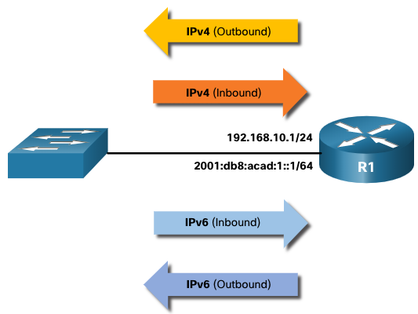
Guidelines for ACL Creation Limited Number of ACLs per Interface
There is a limit on the number of ACLs that can be applied on a router interface. For example, a dual-stacked (i.e, IPv4 and IPv6) router interface can have up to four ACLs applied, as shown in the figure.
Specifically, a router interface can have:
One outbound IPv4 ACL.
One inbound IPv4 ACL.
One inbound IPv6 ACL.
One outbound IPv6 ACL.
Note: ACLs do not have to be configured in both directions. The number of ACLs and their direction applied to the interface will depend on the security policy of the organization.
Notes:
4 - ACL Concepts
4.3 - Guidelines for ACLs
4.3.1 - Limited Number of ACLs per Interface

Slide 14
Guidelines for ACL Creation ACL Best Practices
Using ACLs requires attention to detail and great care. Mistakes can be costly in terms of downtime, troubleshooting efforts, and poor network service. Basic planning is required before configuring an ACL.
Guideline | Benefit
Base ACLs on the organizational security policies. | This will ensure you implement organizational security guidelines.
Write out what you want the ACL to do. | This will help you avoid inadvertently creating potential access problems.
Use a text editor to create, edit, and save all of your ACLs. | This will help you create a library of reusable ACLs.
Document the ACLs using the remark command. | This will help you (and others) understand the purpose of an ACE.
Test the ACLs on a development network before implementing them on a production network. | This will help you avoid costly errors.
Notes:
4 - ACL Concepts
4.3 - Guidelines for ACLs
4.3.1 - Limited Number of ACLs per Interface
4.3.2 - Check Your Understanding - Guidelines for ACL Creation

Slide 15
Types of IPv4 ACLs
Notes:
4 - ACL Concepts
4.4 - Types of IPv4 ACLs

Slide 16
Types of IPv4 ACLs Standard and Extended ACLs
There are two types of IPv4 ACLs:
Standard ACLs - These permit or deny packets based only on the source IPv4 address.
Extended ACLs - These permit or deny packets based on the source IPv4 address and destination IPv4 address, protocol type, source and destination TCP or UDP ports and more.
Notes:
4 - ACL Concepts
4.4 - Types of IPv4 ACLs
4.4.1 - Standard and Extended ACLs

Slide 17
Types of IPv4 ACLs Numbered and Named ACLs
Numbered ACLs
ACLs numbered 1-99, or 1300-1999 are standard ACLs, while ACLs numbered 100-199, or 2000-2699 are extended ACLs.
R1(config)# access-list ?
<1-99> IP standard access list
<100-199> IP extended access list
<1100-1199> Extended 48-bit MAC address access list
<1300-1999> IP standard access list (expanded range)
<200-299> Protocol type-code access list
<2000-2699> IP extended access list (expanded range)
<700-799> 48-bit MAC address access list
rate-limit Simple rate-limit specific access list
template Enable IP template acls
Router(config)# access-list
Notes:
4 - ACL Concepts
4.4 - Types of IPv4 ACLs
4.4.2 - Numbered and Named ACLs

Slide 18
Types of IPv4 ACLs Numbered and Named ACLs (Cont.)
Named ACLs
Named ACLs are the preferred method to use when configuring ACLs. Specifically, standard and extended ACLs can be named to provide information about the purpose of the ACL. For example, naming an extended ACL FTP-FILTER is far better than having a numbered ACL 100.
The ip access-list global configuration command is used to create a named ACL, as shown in the following example.
R1(config)# ip access-list extended FTP-FILTER
R1(config-ext-nacl)# permit tcp 192.168.10.0 0.0.0.255 any eq ftp
R1(config-ext-nacl)# permit tcp 192.168.10.0 0.0.0.255 any eq ftp-data R1(config-ext-nacl)#
Notes:
4 - ACL Concepts
4.4 - Types of IPv4 ACLs
4.4.2 - Numbered and Named ACLs (Cont.)

Slide 19
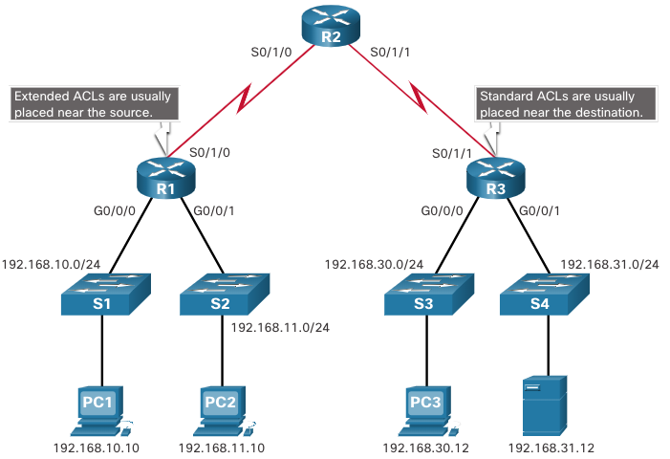
Types of IPv4 ACLs Where to Place ACLs
Every ACL should be placed where it has the greatest impact on efficiency.
Extended ACLs should be located as close as possible to the source of the traffic to be filtered.
Standard ACLs should be located as close to the destination as possible.
Notes:
4 - ACL Concepts
4.4 - Types of IPv4 ACLs
4.4.3 - Where to Place ACLs

Slide 20
Types of IPv4 ACLs Where to Place ACLs (Cont.)
Factors Influencing ACL Placement | Explanation
The extent of organizational control | Placement of the ACL can depend on whether or not the organization has control of both the source and destination networks.
Bandwidth of the networks involved | It may be desirable to filter unwanted traffic at the source to prevent transmission of bandwidth-consuming traffic.
Ease of configuration | It may be easier to implement an ACL at the destination, but traffic will use bandwidth unnecessarily. An extended ACL could be used on each router where the traffic originated. This would save bandwidth by filtering the traffic at the source, but it would require creating extended ACLs on multiple routers.
Notes:
4 - ACL Concepts
4.4 - Types of IPv4 ACLs
4.4.3 - Where to Place ACLs (Cont.)

Slide 21
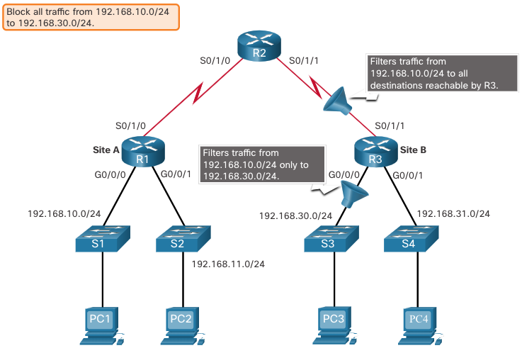
Standard ACL Placement Example
In the figure, the administrator wants to prevent traffic originating in the 192.168.10.0/24 network from reaching the 192.168.30.0/24 network.
Following the basic placement guidelines, the administrator would place a standard ACL on router R3.
Notes:
4 - ACL Concepts
4.4 - Types of IPv4 ACLs
4.4.4 - Standard ACL Placement Example

Slide 22
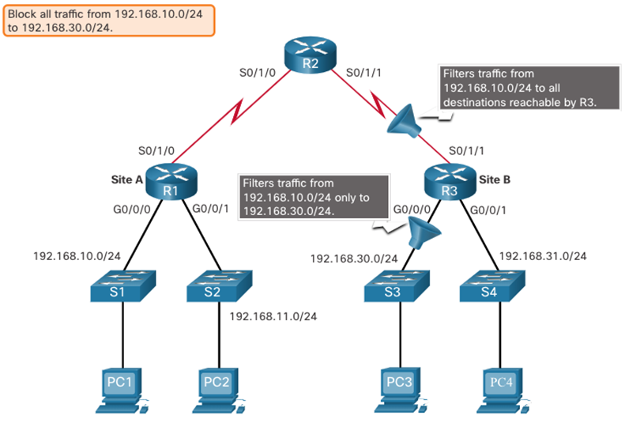
Types of IPv4 ACLs Standard ACL Placement Example (Cont.)
There are two possible interfaces on R3 to apply the standard ACL:
R3 S0/1/1 interface (inbound) - The standard ACL can be applied inbound on the R3 S0/1/1 interface to deny traffic from .10 network. However, it would also filter .10 traffic to the 192.168.31.0/24 (.31 in this example) network. Therefore, the standard ACL should not be applied to this interface.
R3 G0/0 interface (outbound) - The standard ACL can be applied outbound on the R3 G0/0/0 interface. This will not affect other networks that are reachable by R3. Packets from .10 network will still be able to reach the .31 network. This is the best interface to place the standard ACL to meet the traffic requirements.
Notes:
4 - ACL Concepts
4.4 - Types of IPv4 ACLs
4.4.4 - Standard ACL Placement Example (Cont.)

Slide 23
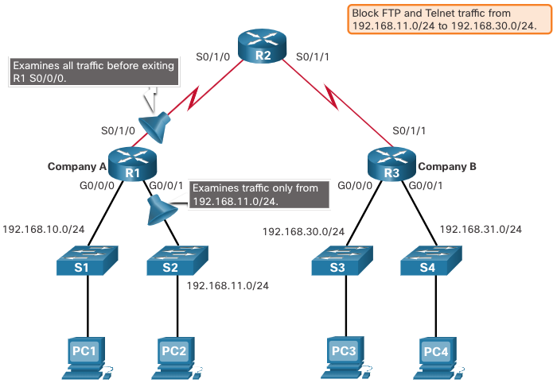
Types of IPv4 ACLs Extended ACL Placement Example
Extended ACLs should be located as close to the source as possible.
However, the organization can only place ACLs on devices that they control. Therefore, the extended ACL placement must be determined in the context of where organizational control extends.
In the figure, for example, Company A wants to deny Telnet and FTP traffic to Company B’s 192.168.30.0/24 network from their 192.168.11.0/24 network, while permitting all other traffic.
Notes:
4 - ACL Concepts
4.4 - Types of IPv4 ACLs
4.4.5 - Extended ACL Placement Example

Slide 24

Types of IPv4 ACLs Extended ACL Placement Example (Cont.)
An extended ACL on R3 would accomplish the task, but the administrator does not control R3. In addition, this solution allows unwanted traffic to cross the entire network, only to be blocked at the destination.
The solution is to place an extended ACL on R1 that specifies both source and destination addresses.
There are two possible interfaces on R1 to apply the extended ACL:
R1 S0/1/0 interface (outbound) - The extended ACL can be applied outbound on the S0/1/0 interface. This solution will process all packets leaving R1 including packets from 192.168.10.0/24.
R1 G0/0/1 interface (inbound) - The extended ACL can be applied inbound on the G0/0/1 and only packets from the 192.168.11.0/24 network are subject to ACL processing on R1. Because the filter is to be limited to only those packets leaving the 192.168.11.0/24 network, applying the extended ACL to G0/1 is the best solution.
Notes:
4 - ACL Concepts
4.4 - Types of IPv4 ACLs
4.4.5 - Extended ACL Placement Example (Cont.)
4.4.5 - Check Your Understanding - Guidelines for ACL Placement

Slide 25
Configure Standard IPv4 ACLs
Notes:
5.0 - ACLs for IPv4 Configuration
5.1 – Configure Standard IPv4 ACLs

Slide 26
Configure Standard IPv4 ACLs Create an ACL
All access control lists (ACLs) must be planned. When configuring a complex ACL, it is suggested that you:
Use a text editor and write out the specifics of the policy to be implemented.
Add the IOS configuration commands to accomplish those tasks.
Include remarks to document the ACL.
Copy and paste the commands onto the device.
Always thoroughly test an ACL to ensure that it correctly applies the desired policy.
Notes:
5.0 - ACLs for IPv4 Configuration
5.1 – Configure Standard IPv4 ACLs
5.1.1 – Create an ACL

Slide 27
Configure Standard IPv4 ACLs Numbered Standard IPv4 ACL Syntax
To create a numbered standard ACL, use the access-list command.
Parameter | Description
access-list-number | Number range is 1 to 99 or 1300 to 1999
deny | Denies access if the condition is matched
permit | Permits access if the condition is matched
remark text | (Optional) text entry for documentation purposes
source | Identifies the source network or host address to filter
source-wildcard | (Optional) 32-bit wildcard mask that is applied to the source
log | (Optional) Generates and sends an informational message when the ACE is matched
Note: Use the no access-list access-list-number global configuration command to remove a numbered standard ACL.
Notes:
5.0 - ACLs for IPv4 Configuration
5.1 – Configure Standard IPv4 ACLs
5.1.2 – Numbered Standard IPv4 ACL Syntax

Slide 28
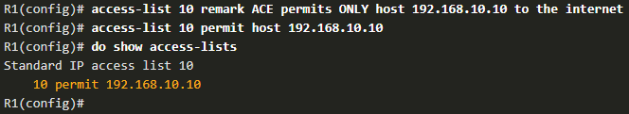
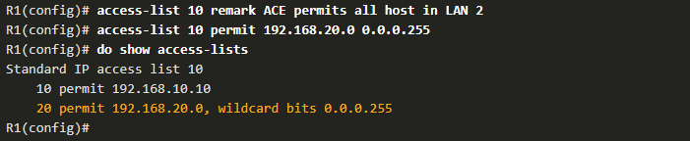

Configure Standard IPv4 ACLs Numbered Standard ACL Example
The example ACL permits traffic from host 192.168.10.10 and all hosts on the 192.168.20.0/24 network out interface serial 0/1/0 on router R1.
Notes:
5.0 - ACLs for IPv4 Configuration
5.1 – Configure Standard IPv4 ACLs
5.1.5 – Numbered Standard IPv4 ACL Example

Slide 29
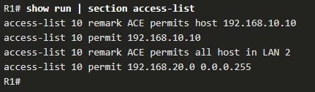
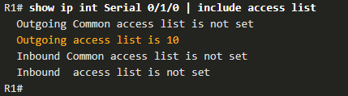
Configure Standard IPv4 ACLs Numbered Standard ACL Example (Cont.)
Use the show running-config command to review the ACL in the configuration.
Use the show ip interface command to verify the ACL is applied to the interface.
Notes:
5.0 - ACLs for IPv4 Configuration
5.1 – Configure Standard IPv4 ACLs
5.1.5 – Numbered Standard IPv4 ACL Example (Cont.)

Slide 30
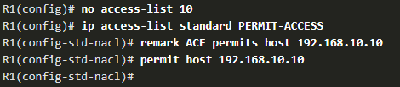
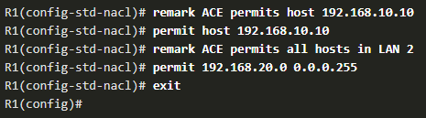

Configure Standard IPv4 ACLs Named Standard ACL Example
The example ACL permits traffic from host 192.168.10.10 and all hosts on the 192.168.20.0/24 network out interface serial 0/1/0 on router R1.
Notes:
5.0 - ACLs for IPv4 Configuration
5.1 – Configure Standard IPv4 ACLs
5.1.6 – Named Standard IPv4 ACL Example

Slide 31
Two Methods to Modify an ACL
After an ACL is configured, it may need to be modified. ACLs with multiple ACEs can be complex to configure. Sometimes the configured ACE does not yield the expected behaviors.
There are two methods to use when modifying an ACL:
Use a text editor.
Use sequence numbers.
Notes:
5.0 - ACLs for IPv4 Configuration
5.2 – Modify IPv4 ACLs
5.2.1 – Two Methods to Modify and ACL

Slide 32

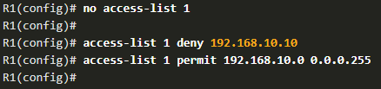
Modify IPv4 ACLs Text Editor Method
ACLs with multiple ACEs should be created in a text editor. This allows you to plan the required ACEs, create the ACL, and then paste it into the router interface. It also simplifies the tasks to edit and fix an ACL.
To correct an error in an ACL:
Copy the ACL from the running configuration and paste it into the text editor.
Make the necessary edits or changes.
Remove the previously configured ACL on the router.
Copy and paste the edited ACL back to the router.
Notes:
5.0 - ACLs for IPv4 Configuration
5.2 – Modify IPv4 ACLs
5.2.2 – Text Editor Method

Slide 33
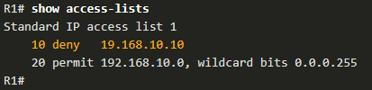
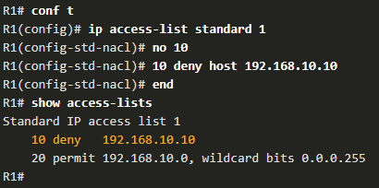
Modify IPv4 ACLs Sequence Number Method
An ACL ACE can be deleted or added using the ACL sequence numbers.
Use the ip access-list standard command to edit an ACL.
Statements cannot be overwritten using an existing sequence number. The current statement must be deleted first with the no 10 command. Then the correct ACE can be added using sequence number.
Notes:
5.0 - ACLs for IPv4 Configuration
5.2 – Modify IPv4 ACLs
5.2.3 – Sequence Number Method

Slide 34
Secure VTY with Standard ACL
Notes:
5.0 - ACLs for IPv4 Configuration
5.3 – Secure VTY Ports with a Standard ACL

Slide 35
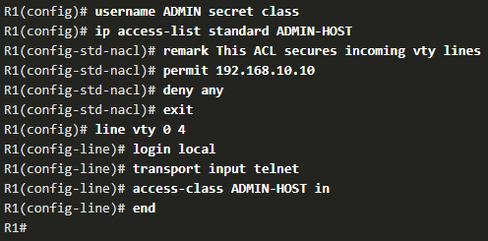
Secure VTY Ports with a Standard IPv4 ACL Secure VTY Access Example
This example demonstrates how to configure an ACL to filter vty traffic.
First, a local database entry for a user ADMIN and password class is configured.
The vty lines on R1 are configured to use the local database for authentication, permit SSH traffic, and use the ADMIN-HOST ACL to restrict traffic.
Notes:
5.0 - ACLs for IPv4 Configuration
5.3 – Secure VTY Ports with a Standard ACL
5.3.2 – Secure VTY Access Example

Slide 36
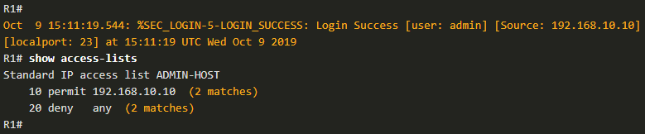
Secure VTY Ports with a Standard IPv4 ACL Verify the VTY Port is Secured
After an ACL to restrict access to the vty lines is configured, it is important to verify it works as expected.
To verify the ACL statistics, issue the show access-lists command.
The match in the permit line of the output is a result of a successful SSH connection by host with IP address 192.168.10.10.
The match in the deny statement is due to the failed attempt to create a SSH connection from a device on another network.
Notes:
5.0 - ACLs for IPv4 Configuration
5.3 – Secure VTY Ports with a Standard ACL
5.3.3 – Verify the VTY Port is Secured
5.3.4 – Syntax Checker – Secure the VTY Ports

Slide 37
Configure Extended IPv4 ACLs
Notes:
5.0 - ACLs for IPv4 Configuration
5.4 – Configure Extended IPv4 ACLs

Slide 38
Configure Extended IPv4 ACLs Extended ACLs
Extended ACLs provide a greater degree of control. They can filter on source address, destination address, protocol (i.e., IP, TCP, UDP, ICMP), and port number.
Extended ACLs can be created as:
Numbered Extended ACL - Created using the access-list access-list-number global configuration command.
Named Extended ACL - Created using the ip access-list extended access-list-name.
Notes:
5.0 - ACLs for IPv4 Configuration
5.4 – Configure Extended IPv4 ACLs
5.4.1 – Extended ACLs

Slide 39
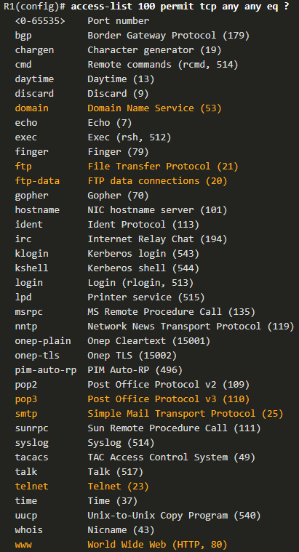
Configure Extended IPv4 ACLs Protocols and Ports (Cont.)
Selecting a protocol influences port options. Many TCP port options are available, as shown in the output.
Notes:
5.0 - ACLs for IPv4 Configuration
5.4 – Configure Extended IPv4 ACLs
5.4.3 – Protocols and Ports

Slide 40
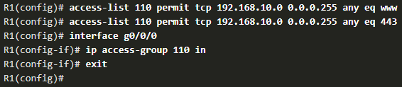
Configure Extended IPv4 ACLs Apply a Numbered Extended IPv4 ACL
In this example, the ACL permits both HTTP and HTTPS traffic from the 192.168.10.0 network to go to any destination.
Extended ACLs can be applied in various locations. However, they are commonly applied close to the source. Here ACL 110 is applied inbound on the R1 G0/0/0 interface.
Notes:
5.0 - ACLs for IPv4 Configuration
5.4 – Configure Extended IPv4 ACLs
5.4.5 – Apply a Numbered Extended IPv4 ACL

Slide 41
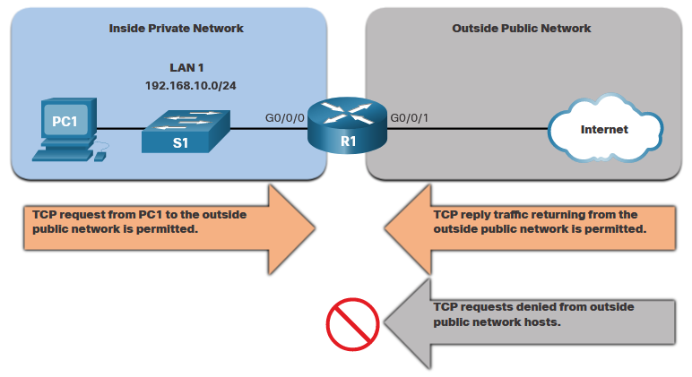
Configure Extended IPv4 ACLs TCP Established Extended ACL
TCP can also perform basic stateful firewall services using the TCP established keyword.
The established keyword enables inside traffic to exit the inside private network and permits the returning reply traffic to enter the inside private network.
TCP traffic generated by an outside host and attempting to communicate with an inside host is denied.
Notes:
5.0 - ACLs for IPv4 Configuration
5.4 – Configure Extended IPv4 ACLs
5.4.6 – TCP Established Extended ACL

Slide 42
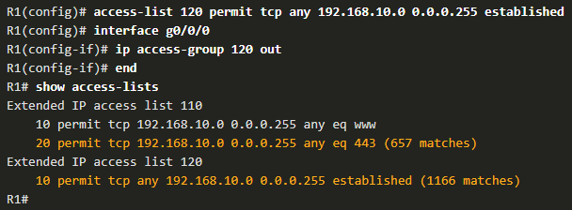
Configure Extended IPv4 ACLs TCP Established Extended ACL (Cont.)
ACL 120 is configured to only permit returning web traffic to the inside hosts. The ACL is then applied outbound on the R1 G0/0/0 interface.
The show access-lists command shows that inside hosts are accessing the secure web resources from the internet.
Note: A match occurs if the returning TCP segment has the ACK or reset (RST) flag bits set, indicating that the packet belongs to an existing connection.
Notes:
5.0 - ACLs for IPv4 Configuration
5.4 – Configure Extended IPv4 ACLs
5.4.6 – TCP Established Extended ACL (Cont.)

Slide 43

Named Extended IPv4 ACL Syntax
Naming an ACL makes it easier to understand its function. To create a named extended ACL, use the ip access-list extended configuration command.
In the example, a named extended ACL called NO-FTP-ACCESS is created and the prompt changed to named extended ACL configuration mode. ACE statements are entered in the named extended ACL sub configuration mode.
Notes:
5.0 - ACLs for IPv4 Configuration
5.4 – Configure Extended IPv4 ACLs
5.4.7 – Named Extended IPv4 ACL Syntax

Slide 44
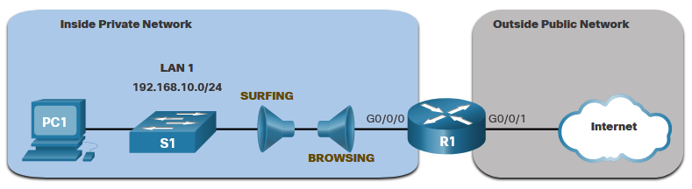
Configure Extended IPv4 ACLs Named Extended IPv4 ACL Example
The topology below is used to demonstrate configuring and applying two named extended IPv4 ACLs to an interface:
SURFING - This will permit inside HTTP and HTTPS traffic to exit to the internet.
BROWSING - This will only permit returning web traffic to the inside hosts while all other traffic exiting the R1 G0/0/0 interface is implicitly denied.
Notes:
5.0 - ACLs for IPv4 Configuration
5.4 – Configure Extended IPv4 ACLs
5.4.8 – Named Extended IPv4 ACL Example

Slide 45
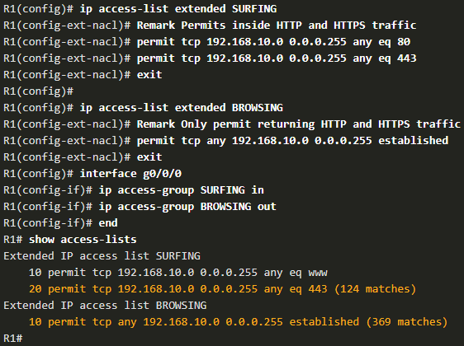
Configure Extended IPv4 ACLs Named Extended IPv4 ACL Example (Cont.)
The SURFING ACL permits HTTP and HTTPS traffic from inside users to exit the G0/0/1 interface connected to the internet. Web traffic returning from the internet is permitted back into the inside private network by the BROWSING ACL.
The SURFING ACL is applied inbound and the BROWSING ACL is applied outbound on the R1 G0/0/0 interface.
Notes:
5.0 - ACLs for IPv4 Configuration
5.4 – Configure Extended IPv4 ACLs
5.4.8 – Named Extended IPv4 ACL Example (Cont.)

Slide 46
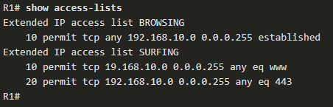
Configure Extended IPv4 ACLs Named Extended IPv4 ACL Example (Cont.)
The show access-lists command is used to verify the ACL statistics. Notice that the permit secure HTTPS counters (i.e., eq 443) in the SURFING ACL and the return established counters in the BROWSING ACL have increased.
Notes:
5.0 - ACLs for IPv4 Configuration
5.4 – Configure Extended IPv4 ACLs
5.4.8 – Named Extended IPv4 ACL Example (Cont.)

Slide 47
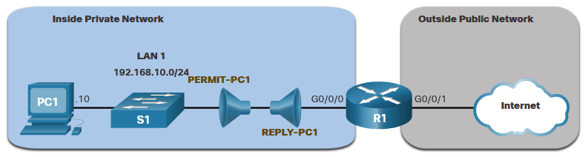
Configure Extended IPv4 ACLs Another Extended IPv4 ACL Example
Two named extended ACLs will be created:
PERMIT-PC1 - This will only permit PC1 TCP access to the internet and deny all other hosts in the private network.
REPLY-PC1 - This will only permit specified returning TCP traffic to PC1 implicitly deny all other traffic.
Notes:
5.0 - ACLs for IPv4 Configuration
5.4 – Configure Extended IPv4 ACLs
5.4.10 – Another Extended IPv4 ACL Example

Slide 48
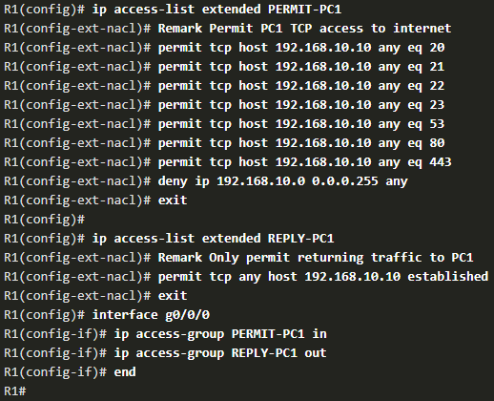
Configure Extended IPv4 ACLs Another Extended IPv4 ACL Example (Cont.)
The PERMIT-PC1 ACL permits PC1 (192.168.10.10) TCP access to the FTP, SSH, Telnet, DNS , HTTP, and HTTPS traffic.
The REPLY-PC1 ACL will permit return traffic to PC1.
The PERMIT-PC1 ACL is applied inbound and the REPLY-PC1 ACL applied outbound on the R1 G0/0/0 interface.
Notes:
5.0 - ACLs for IPv4 Configuration
5.4 – Configure Extended IPv4 ACLs
5.4.10 – Another Extended IPv4 ACL Example (Cont.)

Slide 49
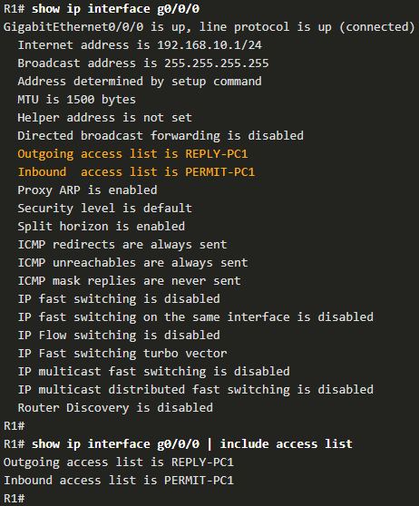
Configure Extended IPv4 ACLs Verify Extended ACLs
The show ip interface command is used to verify the ACL on the interface and the direction in which it was applied.
Notes:
5.0 - ACLs for IPv4 Configuration
5.4 – Configure Extended IPv4 ACLs
5.4.11 – Verify Extended ACLs

Slide 50
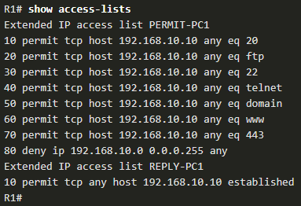
Configure Extended IPv4 ACLs Verify Extended ACLs (Cont.)
The show access-lists command can be used to confirm that the ACLs work as expected. The command displays statistic counters that increase whenever an ACE is matched.
Note: Traffic must be generated to verify the operation of the ACL.
Notes:
5.0 - ACLs for IPv4 Configuration
5.4 – Configure Extended IPv4 ACLs
5.4.11 – Verify Extended ACLs (Cont.)

